Slide 1
Your slide is ready.
Demystifying AI:
From LLMs to Intelligent Agents
Navigating the shift from static text generation to autonomous, goal-oriented systems.

Slide 2
Software is Evolving from a Static Tool to an Active Helper
How Artificial Intelligence is transforming human-machine collaboration
Artificial Intelligence is fundamentally changing how we interact with software.
STATIC TOOLS
Command-Driven Legacy
Historically, software required explicit, step-by-step human commands to function.
ACTIVE HELPERS
Probabilistic Collaboration
Today, foundation models act as powerful probabilistic engines, transforming applications into active collaborators. Rather than just executing hardcoded rules, modern AI systems understand context, predict outcomes, and assist in complex decision-making, bridging the gap between human intent and machine execution.

Slide 3
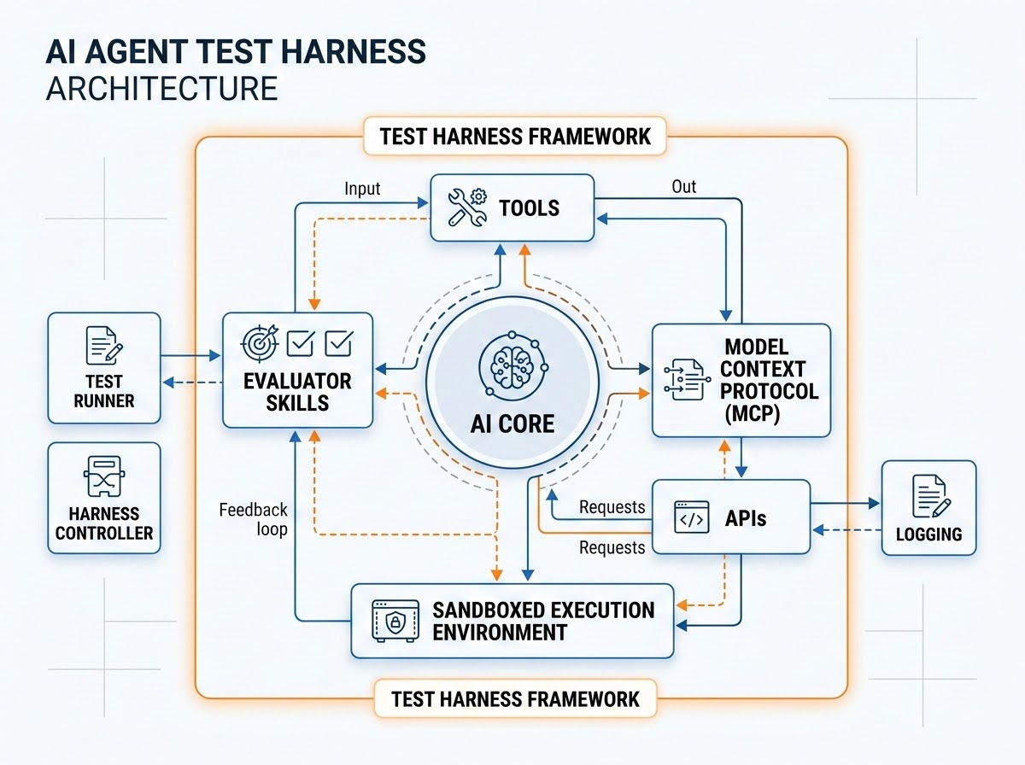
Anatomy of an Agent
Comprehensive environment for evaluating agents, tools, MCP protocols, and execution skills
AGENT = MODEL + HARNESS
Harness engineering is how we build systems around Models to turn them into work engines. The model contains the intelligence and the harness makes that intelligence useful.
If you're not the model, you're the harness.
MCP Server Integration: Bridges standard Model Context Protocol clients with custom knowledge-retrieval pipelines.
Unified Tool APIs & Skills: Manages stateful tool lifecycles, permission scopes, authentication, and execution telemetry across distributed systems.

Slide 4
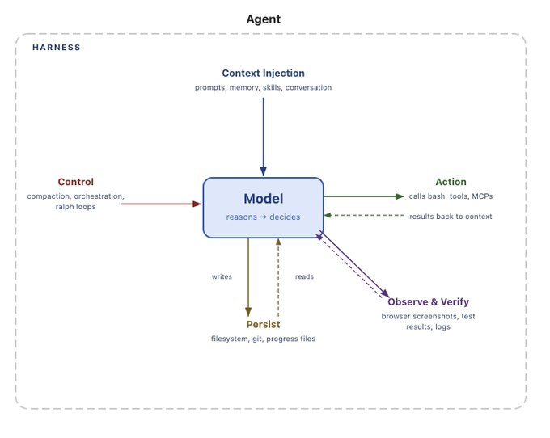

Slide 5
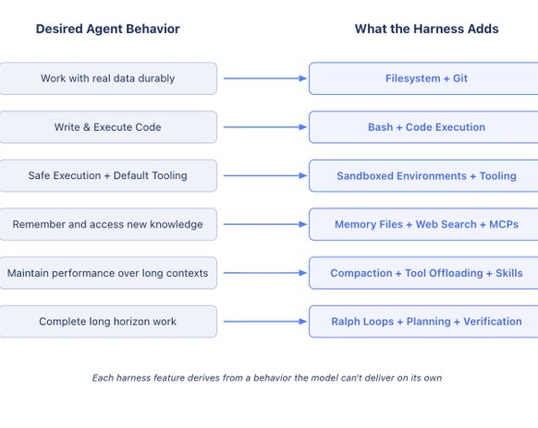

Slide 6
Your slide is ready.
Agent Workflow
The end-to-end cognitive pipeline from system prompt to safe output generation
01 / INPUT
System Prompt
Initial rules, persona definitions, and core task constraints.
02 / SETUP
Context Injection
Dynamic user query, session variables, and situational data.
03 / MEMORY
Long-term Memory
Retrieving historical context and past vector embeddings.
04 / SHIELD
Guardrails (In)
Safety checks, input validation, and prompt injection filters.
05 / BRAIN
LLM / Core Model
The foundational probabilistic processing unit. Decides reasoning paths, synthesizes variables, and initiates downstream actions.
08 / OUTPUT FILTER
Guardrails (Out)
Sanitizes final model response. Detects hallucinations, monitors format compliance, and prevents data leakages.
07 / PERSISTENCE
State & Memory Sync
Writes back execution states, updates the durative scratchpad, and commits changes to filesystem or databases.
06 / EXECUTION TOOLS
Action & Skill Orchestration
Calls APIs and Model Context Protocol (MCP) servers. Executes code in sandboxed runtime environments and fetches system telemetry.
Execution Complete

Slide 7

01 - Crafting the System Prompt
How User History and Active Inputs Synthesize the Foundation
01 / HISTORICAL CONTEXT
User History Integration
To personalize interactions, the orchestrator pulls relevant context from past queries, preferences, and long-term memory variables.
Key Variables Loaded:
user_name: Rangel Soares
timezone: Europe/Lisbon
past_topics: AI, Dev tools
02 / ACTIVE INPUTS
Personas
You are a java specialist
Active Payload Elements:
query: You are a java specialist
language: java
framworks: spring
03 / COMPILATION
Synthesized System Prompt
The final consolidated payload compiled at runtime before hitting the Core Model
// Assemble system prompt
sys_prompt = build({
rules: system_rules,
history: user_context,
input: current_query
});

Slide 8
01 - The Journey of a Prompt / Model
From Tokenization to Prediction
Tokenization & Embeddings
Attention Layers
Next Token Prediction
Transformation Pipeline
Prompts undergo a precise sequence of computational steps:
Tokenization & Embeddings break text into chunks and map them to semantic vector spaces.
Attention Layers calculate dynamic weights and evaluate token relationships.
Next Token Prediction generates the highest-probability output for detokenization.
Context Optimization Rule
1 Token ≈ 4 English Characters
To avoid exceeding limits, the system dynamically monitors context window thresholds and triggers adaptive compression:
if (prompt_chars / 4) > (context_window / 2) {
// Summarize context (Hermes-style)
compress_and_merge_context();
}

Slide 9
02/03 - Context Injection & Memory
Dynamic user query, session variables, and situational data
DYNAMIC ENRICHMENT
Real-Time Data Integration
Before sending the compiled instruction to the model, the orchestrator dynamically augments the session with environment variables, safety constraints, and user metadata.
Injected Contextual Layers:
Dynamic User Query: Direct instructions or files provided in the active session.
Session Variables: Location, local timezone, and preferred identity settings.
Situational Awareness: Real-time platform states and historical context.
EXECUTION PIPELINE
Memory Injection Logic
The orchestration layer dynamically targets variables and evaluates the payload length to inject contextual data without overloading the model's window:
// Inject dynamic state
payload.history = fetch_context(user.id);
payload.session = {
time: "22:51:24",
zone: "Europe/Lisbon"
};
payload.inject_active_inputs();

Slide 10
04 - Guardrails (In)
Securing the Gateway Before Execution
01 / INPUT SHIELD
Proactive Safety Checks
Every incoming user prompt must pass strict alignment guidelines to ensure system stability and compliance.
Core Defenses Activated:
Prompt Injection: Blocking malicious overrides and jailbreak attempts.
Safety Filters: Preventing toxic, harmful, or illegal request propagation.
02 / STRUCTURE VALIDATION
Format Verification
Ensuring incoming metadata, variables, and structure conform precisely to standard expectations.
Validation Rules:
Type Checking: Validating language references.
Size Restrictions: Blocking oversized payloads early.
03 / GATEKEEPER DECISION
Evaluating Request
The evaluation runs dynamically at the edge to instantly drop bad requests.
// Guardrails Evaluation
eval = shield(query);
if (eval.flagged) {
throw BlockedRequest();
}

Slide 11
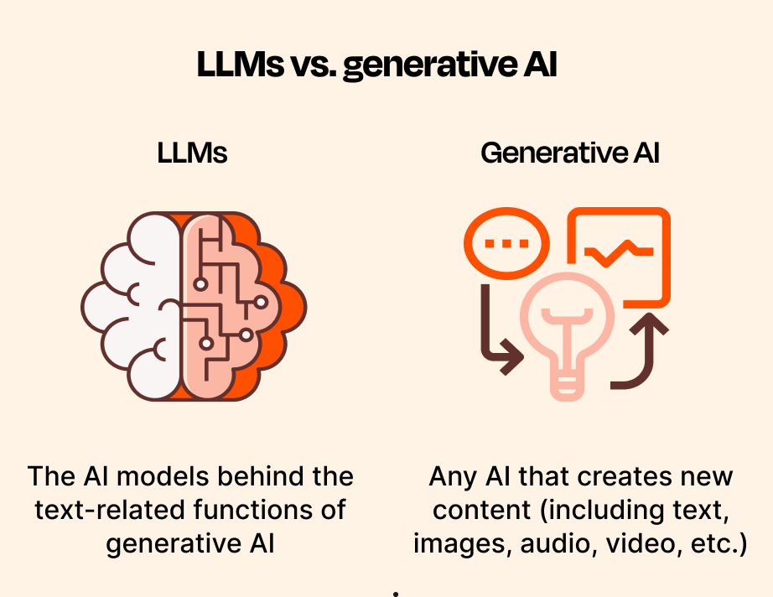
05 - What is a Large Language Model (LLM)?
The foundational probabilistic engines powering modern artificial intelligence
CORE CONCEPT
Deep Learning at Scale
At its core, a Large Language Model (LLM) is a highly sophisticated neural network trained on vast amounts of text data. It processes and generates human-like language by calculating statistical probabilities.
Transformer Architecture: Utilizes self-attention mechanism to understand context and relationships between words in a sequence.
Pattern Recognition: Learned from massive datasets, enabling translation, reasoning, coding, and structured output generation.
Next Token Prediction: Operates fundamentally by calculating the highest-probability next word or sub-word (token) given a context window.

Slide 12

06 - MCP
PROTOCOL ARCHITECTURE
Standardizing Interoperability
Connecting AI models to external tools & data
01 / HOST
AI Applications
Initiates connections and coordinates model activities.
02 / CLIENT
Protocol Orchestrator
Maintains active context and manages secure requests.
The Model Context Protocol (MCP) establishes a universal language for linking AI models with data sources and tools.
By standardizing connection patterns, MCP allows developers to seamlessly plug any supported AI model into enterprise infrastructure. This bypasses the need to build and maintain custom, brittle integrations for every single model or data source.
03 / SERVER
Tools & Data Repositories
Exposes data resources and execution tools securely.

Slide 13

06 - Reusable Skills
Standardizing behavior through portable and deterministic instructions
CORE ARCHITECTURE
Deterministic Skill Definition
Unlike general system prompts, skills are modular, highly-specific packages designed to inject reliable capabilities directly into compatible agent runtimes.
100% Reusable: Easily shared across completely different model configurations and custom-built assistants.
Deterministic Executions: Standardizes outputs by constraining reasoning boundaries using strict structural rules.
No-Code Integration: Enables rapid behavioral alignment without changing underlying model weights.
SPECIFICATION
Markdown-Based Configurations
Skills are strictly written in pure Markdown (.md) format. This ensures they are perfectly parsed by both LLMs and standard developer environments.
# skill_format.md
---
name: text_structured_parser
type: deterministic_utility
---
## 1. Objectives
- Extract parameters cleanly
- Output pure JSON schemas

Slide 14
07 - State & Memory Synchronization
Ensuring Agent Continuity through Durative Persistence and Scratchpad Updates
07 / STATE PERSISTENCE
Execution Tracking
The orchestrator commits current execution variables to the database to ensure state recovery and durability.
State Attributes Saved:
session_id: active_run
step_index: 07_sync
agent_status: persisting
07 / SCRATCHPAD UPDATES
Durative Context
Updates the system scratchpad dynamically, merging real-time outcomes back into the context window.
Latest Commit Payload:
// Memory scratchpad
scratchpad.update({
state: "java_spring",
db_changes: true
});
07 / SYNCHRONIZATION
Filesystem Commit
Final write-back operation executed before output filtering. All files and database mutations are securely flushed to the disk.
Active I/O Channels:
Target: PostgreSQL / Git
Action: commit_state()
Result: sync_verified_ok

Slide 15


07 - Agentic Memory Systems
Procedural, Semantic, and Episodic Architectures for Cognitive Continuity
SYSTEM SKILLS & FLOWS
Procedural Memory
Stores the rule-based execution steps, operational workflows, and behavioral logic that dictate how the agent performs multi-step reasoning processes.
When to use:
For executing standardized loops, tool invocations, structural parsing guidelines, and complex deterministic sequences.
// Execution flow logic
agent.execute_skill("ReactLoop");
KNOWLEDGE BASE & FACTS
Semantic Memory
Acts as the core repository of structured facts, system concepts, specialized ontologies, and static background information integrated into the context window.
When to use:
For querying schema definitions, resolving domain-specific terminology, and retrieving business rules from a vector store.
// Query knowledge graph
vector_store.search("JSON_schema");
RUN-TIME HISTORY
Episodic Memory
Captures the temporal chain of raw execution histories, previous user interactions, tool execution outputs, and conversational state variables.
When to use:
For contextualizing ongoing multi-turn conversations, maintaining state, auditing decisions, and recovering from historical failures.
// Recover past trial
scratchpad.get_history(run_id);

Slide 16
08 - Output Filter Guardrails
Sanitizing the Model Response and Ensuring Safety Compliance Before Exit
STEP 08 / OUTPUT FILTER
Guardrails (Out)
The final gatekeeping layer in the cognitive pipeline. It guarantees that the response returned to the user is clean, correct, and strictly aligned with safety and structural specifications.
Core Operations:
Sanitize Responses: Strips sensitive strings and prevents inadvertent leakage of system prompts.
Detect Hallucinations: Verifies generated answers against dynamic context bounds.
Format Validation: Ensures structured JSON or code block payloads conform to requested schemas.
VERIFICATION RULES
Active Compliance Check
The orchestrator subjects the raw text output to programmatic validators before returning the payload to the external interface.
// Run outbound filter audit
let audit = outbound_shield.verify({
response: model_raw_output,
allow_leakage: false,
schema: target_schema
});
if (audit.passed) {
return deliver(audit.clean);
} else {
throw SecurityException("Leak/Format Err");
}

Slide 17
Agent Loop & Execution Resilience
Self-Correction, Output Validation, and Hard Budget Limits
OUTPUT VALIDATION
Self-Correction Loop
If the agent's output fails structural validation (e.g., malformed JSON or invalid tool schemas), the validator catches the error and feeds it directly back to the agent for an immediate correction attempt.
// Retry logic on validation error
if (!validate(output)) {
agent.retry(error);
}
EXECUTION SAFETY
Token & Budget Limits
To prevent runaway loops and infinite recursion, strict maximum execution step and token usage thresholds are actively monitored at runtime. Exceeding these limits triggers an immediate graceful termination.
// Protect context window
if (tokens.used > limit) {
throw new TokenLimitException();
}
RESILIENCE METRICS
Loop Control Guard
Programmatic execution states ensure that state machines maintain determinism within non-deterministic environments, tracking exact state changes across every turn.
// Max turn threshold guard
if (turns >= MAX_TURNS) {
return fallback_response();
}

Slide 18
The ReAct Loop
Enables Continuous Planning and Execution
Phase 01
Plan
Phase 02
Act
Phase 03
Observe
If goal is not met: Feed observation back to adjust plan
The Iterative Cycle
Intelligent agents navigate complex tasks using the ReAct (Reasoning and Acting) loop. This iterative cycle consists of three phases: Plan, Act, and Observe. The agent analyzes the goal to formulate a Plan...
Continuous Execution
...uses tools to Act on that plan, and then Observes the results of the action. If the goal is not met, the agent feeds the observation back into the system to adjust its plan, iterating until the objective is fully resolved.

Slide 19

Evaluation Harnesses Ensure Reliability
in Non-Deterministic Systems
Trust and safety are paramount when deploying AI. Because LLMs are non-deterministic—meaning they can generate different outputs for the same input—we must implement robust quality control.
EVALUATION & TESTING
Automated Benchmarks & Test Runners
Test runners systematically evaluate agent performance against standardized datasets.
GUARDRAILS & MONITORING
Real-time Guardrails & Output Monitoring
Real-time guardrails monitor outputs to prevent hallucinations, ensuring the system remains reliable and aligned with business policies.

Slide 20



Concluding Insight
AI is Transitioning from an Assistant to a Collaborator
"The future of work involves humans setting high-level strategy while agents manage execution."
The evolution from basic LLMs to intelligent agents marks a shift from Copilots to Autopilots. As these systems gain reasoning loops, tool access, and standardized protocols like MCP, they become true collaborators rather than just assistants. Organizations must begin exploring agentic workflows today to harness the next generation of automated productivity.

